Slide 1
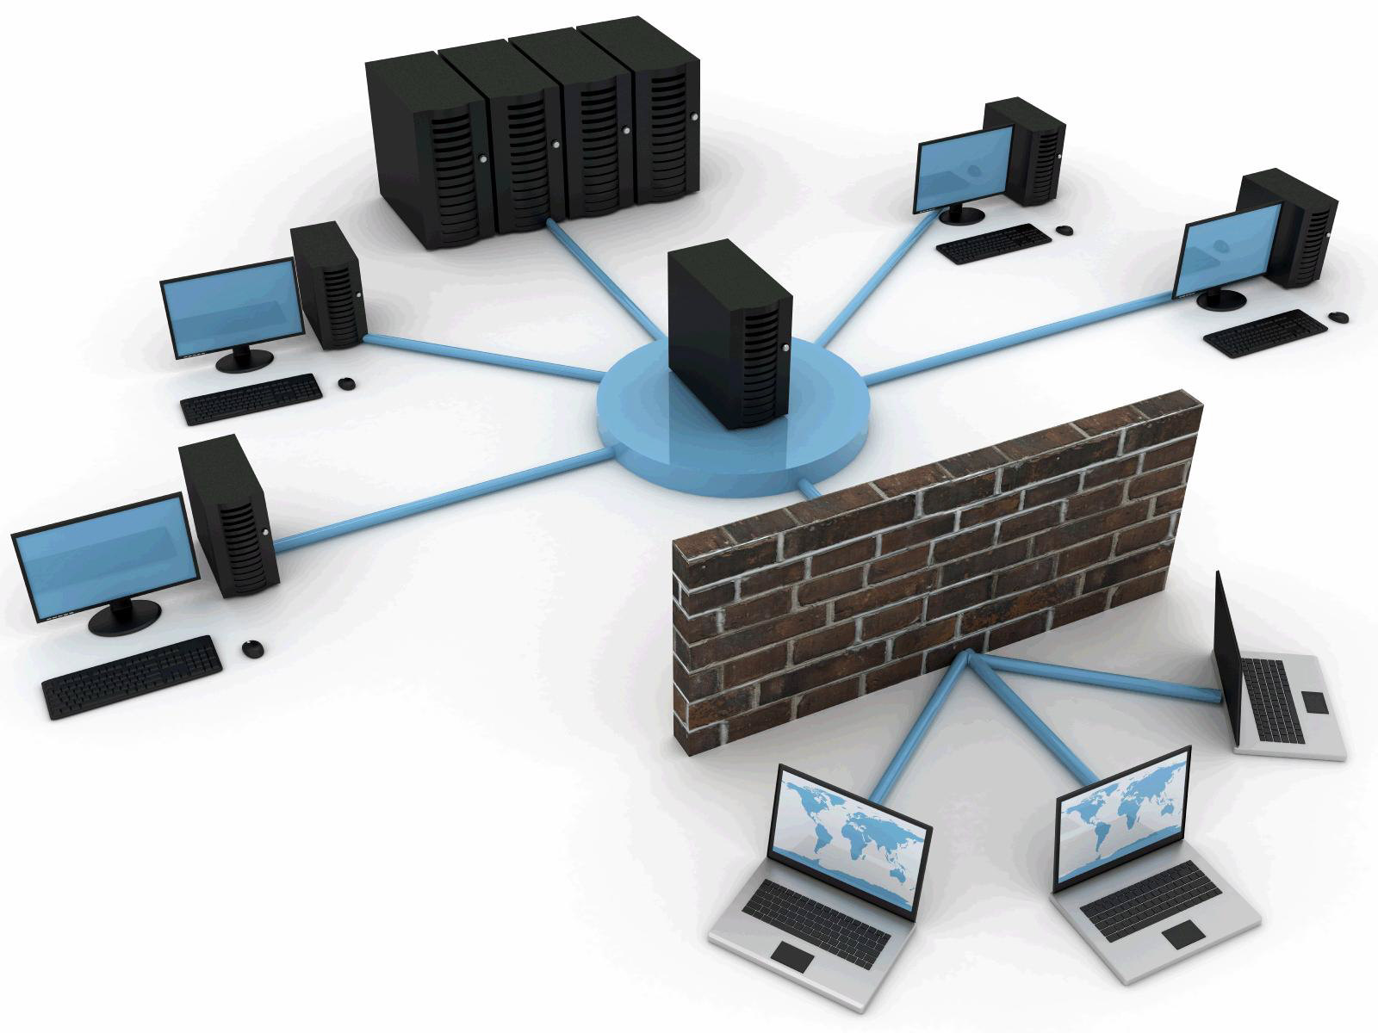


Slide 2

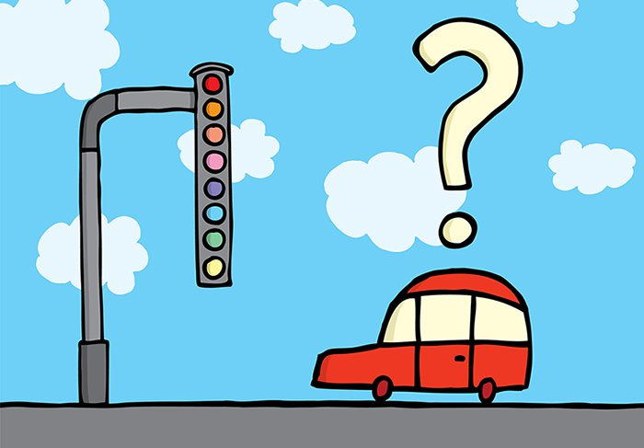
NETWORK PROTOCOLS
Network Protocol is a set of rules that governs the communication between computers/devices on a network.
Used to describe how devices can communicate.
Define how various operations are to be performed.
Define how devices outside the network can interact with the network.
Define various services and utility programs.

Slide 3

RFC’s :-
Protocols are outlined in Request for Comments (RFCs).
RFC 1122 - Defines host requirements of the TCP/IP suite of protocols covering the link, network (IP), and transport (TCP, UDP) layers.
RFC 1123 - The companion RFC to 1122 covering requirements for Internet hosts at the application layer.
RFC 1812 - Defines requirements for Internet gateways which are IPv4 routers.

Slide 4
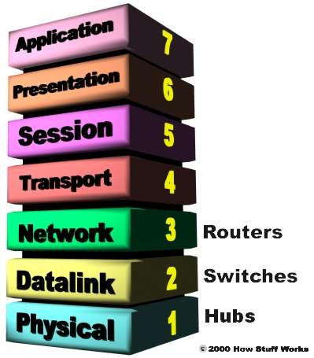
OSI model (Open Systems Interconnection) :-
All
People
Seem
To
Need
Data
Processing

Slide 5
Physical Layer - The actual hardware.
Data Link Layer - Data transfer method (802x Ethernet).
- Puts data in frames.
- Ensures error free transmission.
- Controls the timing of the network transmission.
IEEE divided this layer into the two sublayers :-
Logical Link control (LLC) - Maintains the Link between two computers by establishing Service Access Points (SAPs).
Media Access Control (MAC) - Hardware address of the card.
Network Layer - IP network protocol.
- Routes messages using the best path available.
Transport Layer - TCP, UDP. Ensures properly sequenced and error free transmission.

Slide 6
Session Layer - The user's interface to the network.
- Determines when the session is begun or opened, how long it is used, and when it closed.
- Controls the transmission of data during the session.
- Supports security and name lookup enabling computers to locate each other.
Presentation Layer - Used to translate data to computer specific format such as byte ordering.
- It may include compression.
- It prepares the data, either for the network or the application depending on the direction it is going.
Application Layer - Provides services software applications need. - Provides the ability for user applications to interact with the network.

Slide 7
TCP/IP :-
Transmission Control Protocol / Internet Protocol
Four layer protocol
1) Link
2) Network
3) Transport
4) Application
1) Link - Device driver and interface card which maps to the data link and physical layer of the OSI model.
2) Network - Corresponds to the network layer of the OSI model and includes the IP, ICMP, and IGMP protocols.
3) Transport - Corresponds to the transport layer and includes the TCP and UDP protocols.
4) Application - Corresponds to the OSI Session, Presentation and Application layers and includes FTP, Telnet, ping, Rlogin, rsh, TFTP, SMTP, SNMP, DNS, your program, etc.

Slide 8
Protocols :-
Ethernet - Provides for transport of information between physical locations on Ethernet cable. Data is passed in Ethernet packets.
SLIP - Serial line IP (SLIP), a form of data encapsulation for serial lines.
PPP - Point to point protocol (PPP). A form of serial line data encapsulation that is an improvement over SLIP.
IP - Internet Protocol (IP). Except for ARP and RARP all protocols' data packets will be packaged into an IP data packet.
ICMP - Internet control message protocol (ICMP) provides management and error reporting to help manage the process of sending data between computers.
ARP - Address resolution protocol (ARP) enables the packaging of IP data into Ethernet packages. It is the system and messaging protocol that is used to find the Ethernet (hardware) address from a specific IP number.
TCP - A reliable connection oriented protocol used to control the management of application level services between computers.
UDP - An unreliable connection less protocol used to control the management of application level services between computers.

Slide 9
DNS - Domain Name Service, allows the network to determine IP addresses from names and vice versa.
RARP - Reverse address resolution protocol (RARP) to determine its IP address from its Ethernet address.
BOOTP - Bootstrap protocol is used to assign an IP address to disk less computers and tell it what server and file to load which will provide it with an operating system.
DHCP - Dynamic host configuration protocol (DHCP) is a method of assigning and controlling the IP addresses of computers on a given network.
IGMP - Internet Group Management Protocol used to support multicasting.
SNMP - Simple Network Management Protocol (SNMP). Used to manage all types of network elements based on various data sent and received.
RIP - Routing Information Protocol (RIP), used to dynamically update router tables on WANs or the internet.
OSPF - Open Shortest Path First (OSPF) dynamic routing protocol.
BGP - Border Gateway Protocol (BGP). A dynamic router protocol to communicate between routers on different systems.

Slide 10
CIDR - Classless Interdomain Routing (CIDR).
FTP - File Transfer Protocol (FTP). Allows file transfer between two computers with login required.
TFTP - Trivial File Transfer Protocol (TFTP). Allows file transfer between two computers with no login required. It is limited, and is intended for diskless stations.
SMTP - Simple Mail Transfer Protocol (SMTP).
POP3 – Post Office Protocol 3.
NFS - Network File System (NFS). A protocol that allows UNIX and Linux systems remotely mount each other's file systems.
Telnet - A method of opening a user session on a remote host.
Ping - A program that uses ICMP to send diagnostic messages to other computers to tell if they are reachable over the network.
Rlogin - Remote login between UNIX hosts. This is outdated and is replaced by Telnet.

Slide 11
THANK YOU … !!!

